Slide 1
Development of Mobile Application for Measuring Vehicle Ride Comfort and Road Surface Quality
Mun Chun Mah
mun.mah13@imperial.ac.uk
Department of Civil and Environmental Engineering Imperial College London
13 June 2017

Slide 2
Motivations
Potholes
4000 deaths in Korea
£118 million to fix (1 year)
£20 million savings

Slide 3
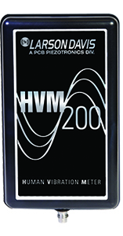
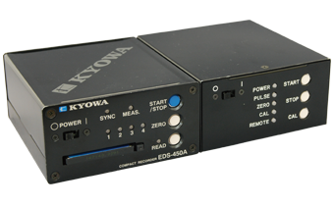
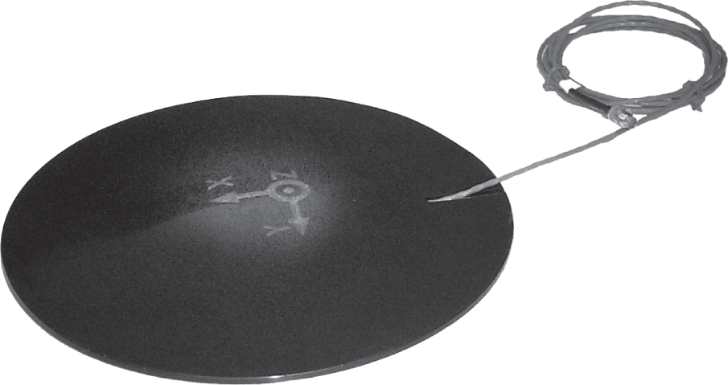
Seat pad
STAMPER

Slide 4
Motivations
Potholes
4000 deaths in Korea
£118 million to fix (1 year)
£20 million savings
Specially built devices
£30,000 per unit
Ride comfort via ISO-2631 standard
Vehicle costs (Price of car, maintenance, driver wage)
App Savings
£30,000 per STAMPER unit
Vehicle Costs
£20 million savings

Slide 5
Project Objectives
Can smartphones replace specially built devices like STAMPER or the HVM200 seat pad?
Build a prototype
Results comparable to HVM200?
GPS capabilities
GPS coordinates accurate?
Do phone models matter?
How would you use the app in a car?

Slide 6
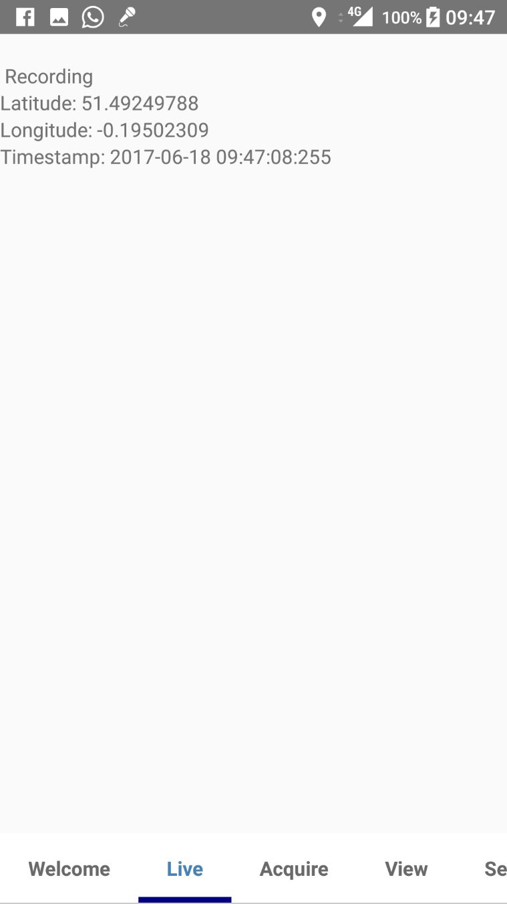


App Demo

Slide 7
Experiments
Bicycle Test

Slide 8
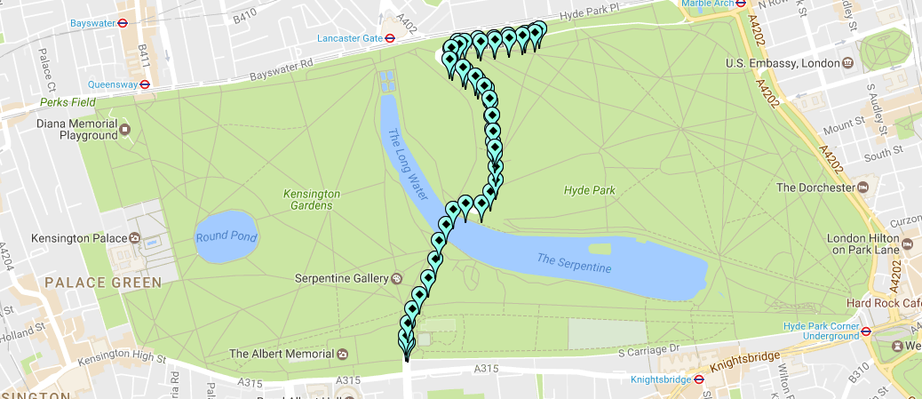
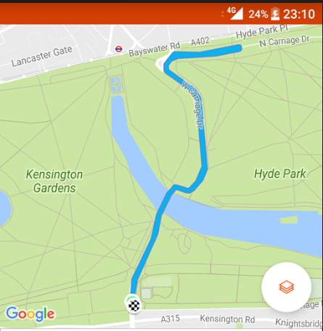

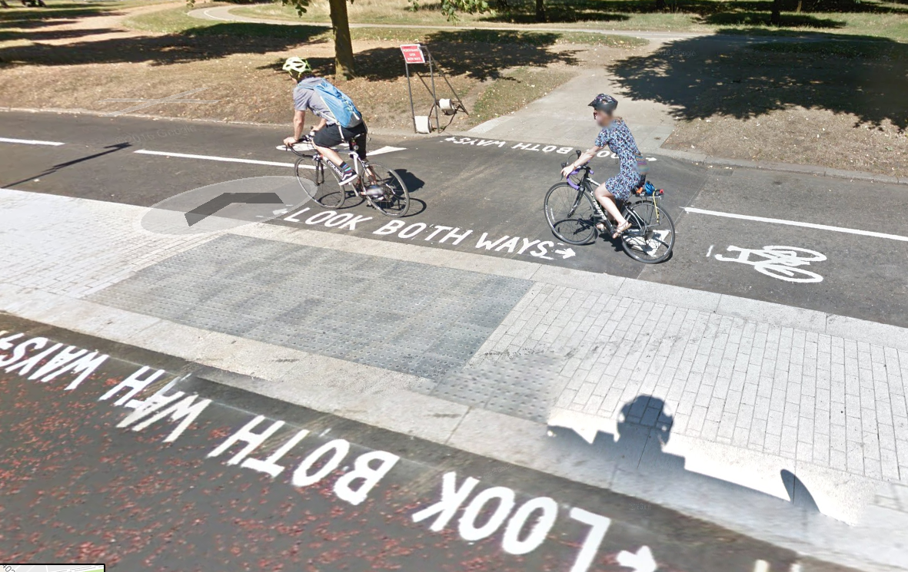
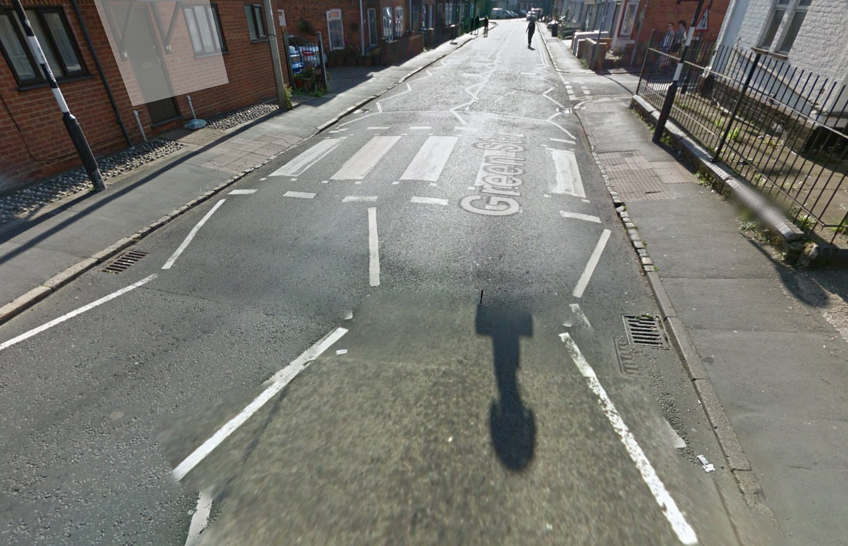
GPS
Coordinates by Phone App
Actual Location
3m width, error of 2.57m.
5m width, error of 16.27m

Slide 9
Experiments
Bicycle Test
In Vehicle Test

Slide 10
In Vehicle Test
Route Taken
Urban Roads
Rural Roads
Motorway
2 phones used
Unconstrained
Constrained
HVM200 Seat Pad also present
Time Alignment

Slide 11
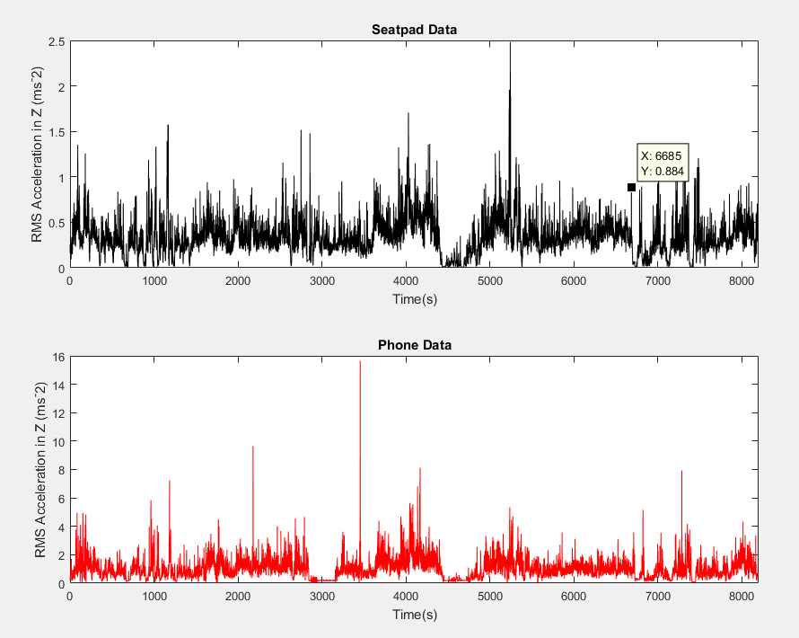
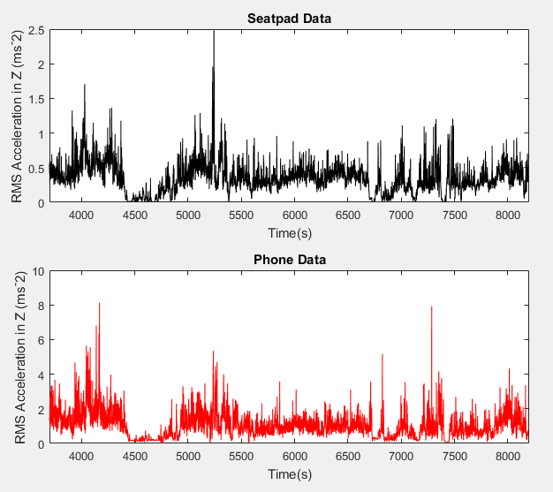
Accelerometer Accuracy (2)
Unconstrained
R = 0.26
Figure 1: Seatpad (top) against Phone App (bottom) without data modification
R = 0.70
Figure 2: Seatpad (top) against Phone App (bottom) with data modification

Slide 12
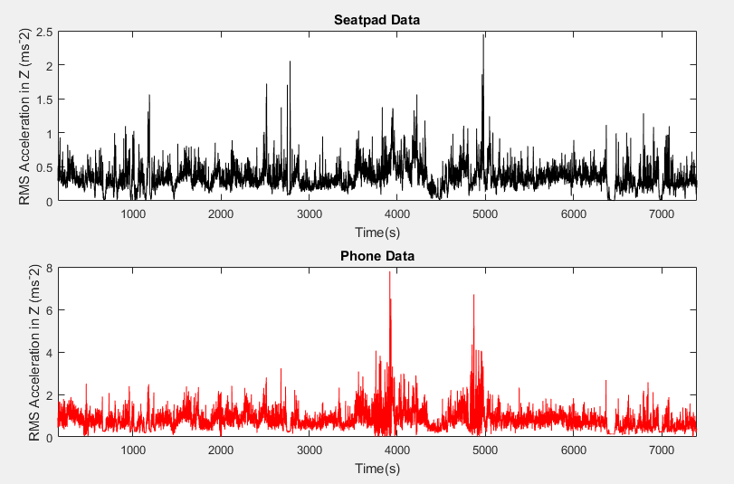
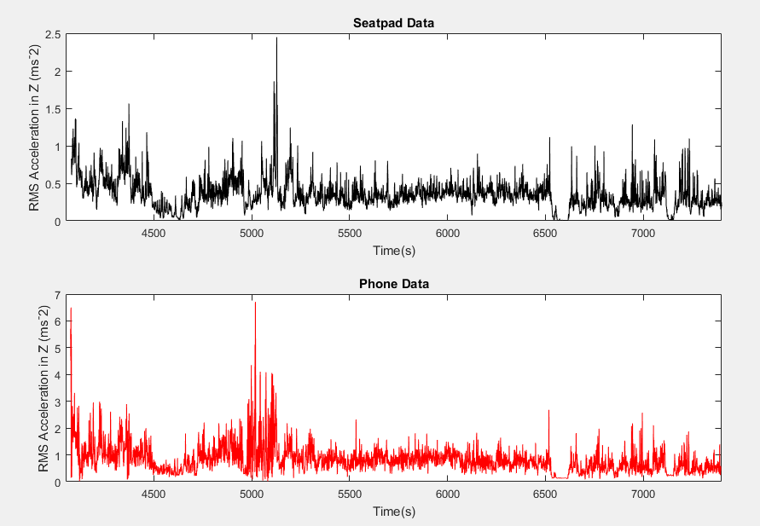
Accelerometer Accuracy (3)
Constrained
R = 0.51
Figure 1: Seatpad (top) against Phone App (bottom) without data modification
R = 0.71
Figure 2: Seatpad (top) against Phone App (bottom) with data modification

Slide 13
Project Objectives - Conclusion
Can smartphones replace specially built devices like STAMPER or the HVM200 seat pad?
Build a prototype
Results comparable to HVM200?
GPS capabilities
GPS coordinates accurate?
Do phone models matter?
How would you use the app in a car?
Correlation Coefficient of 0.5 – 0.7
Error between 2m – 16m
No significant impacts using
different phone models
Constrained Phone recommended
Pothole Detection Capability
at 70% true positive
Linear model insufficient to predict
Observed values.

